Slide 1


NATIONAL INSTITUTE OF SCIENCE & TECHNOLOGY

Slide 2
HOSPITAL MANAGEMENT
A
complete solution for Hospital Services.

Slide 3
NI
S
T
REPRESENTED BY OUR TEAM MEMBERS
K.ANIL KUMAR
NANDINI REDDY
MAlAYA KUMAR
KAMESWARI PATRA
V.LIKHITA
T.REBECCA

Slide 4


Slide 5
“ What Is Hospital Management “
Is a term very broad in scope and may be defined from different aspects.
It mainly relates to management of all aspects of a hospital ,a coordination of all elements of a hospital.
This may range from patient care to record keeping to inventory of medicines and cleanliness.

Slide 6
1.HEADER FILE
2.CLASS USED IN PROJECT
3.FUNCTION DECLARATION
4.MAIN FUNCTION
5.FUNCTION DETAILS

Slide 7
HEADER FILE USED IN PROJECT
#include<iostream>
iostream ,a header file that is part of the c++ standard library the name stands for Input/Output Stream.
2. #include<fstream>
This data type represents the file stream generally,and has the capabilities of both ofstream
And ifstream which means it can create files, write information to files,and read information
From files.
3. #include<stdio.h>
It is the header file for standard Input and Output.It is useful for getting the input from the user and output result text to the screen.
4. #include<conio.h>
This header file declares several useful library functions for performing console Input and Output from a program.

Slide 8
5. #include<windows.h>
The header file in particular includes the library and functions used in the libraries like stdio.h and stdlib.h.
6. #include<stdlib.h>
It defines four variable,several macros,and various functions for performing general functions.
7.#include<iomanip>
It is used to manipulate the Output of cpp program.This function may be conveniently used by cpp to effect the state of iostream.
8.#include<time.h>
It is used to define clock_t,size_t ,time_t,clockid_t,timer_t,locale_t,pid_t.

Slide 9
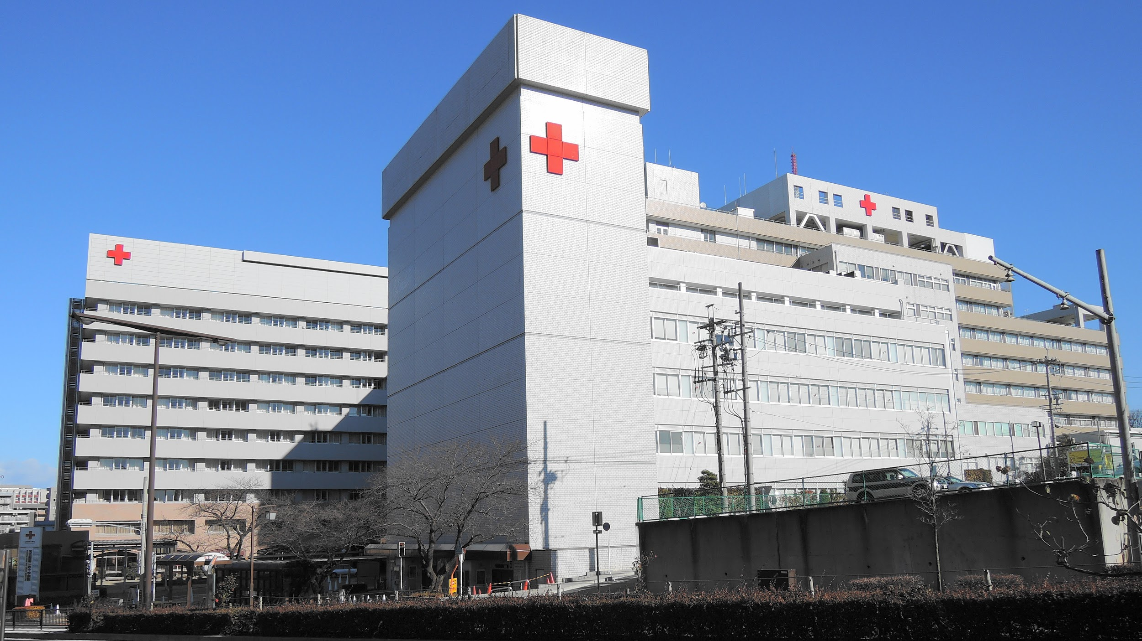


Slide 10
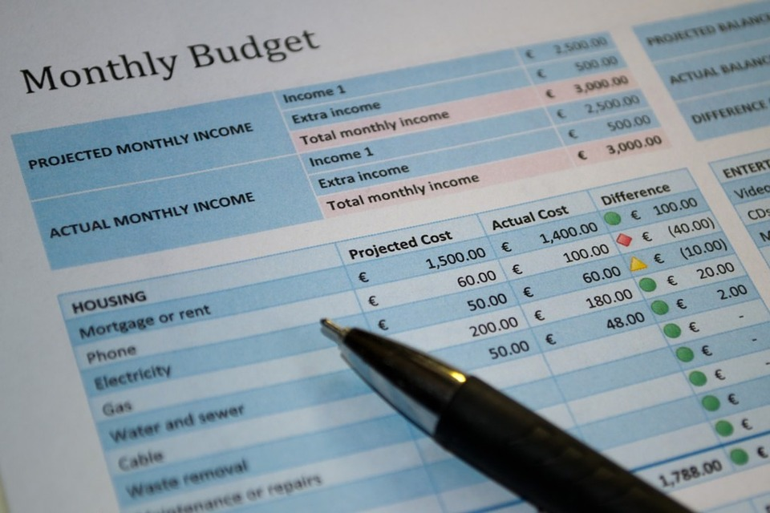
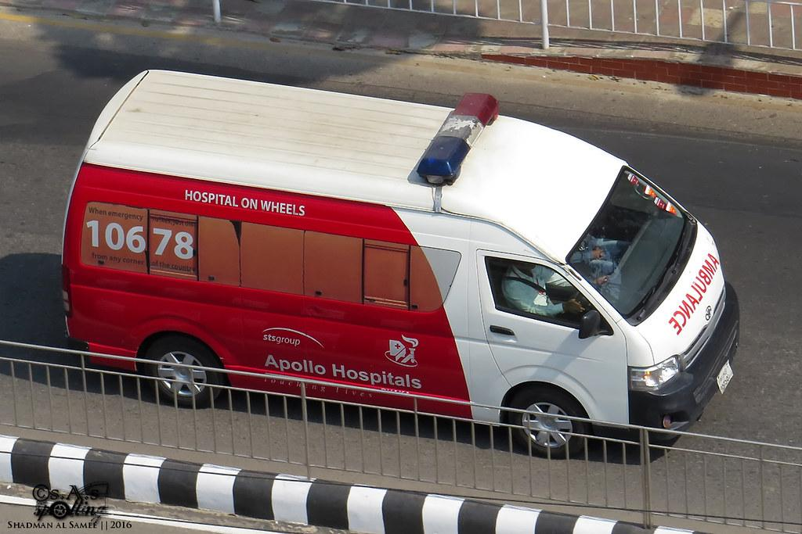
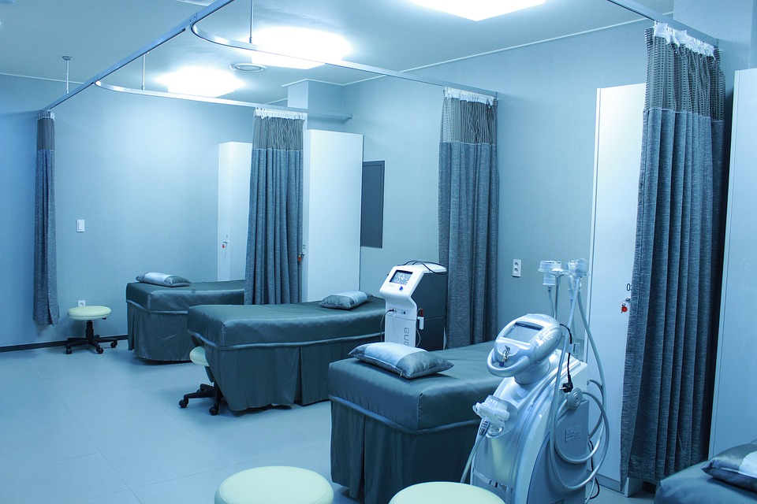
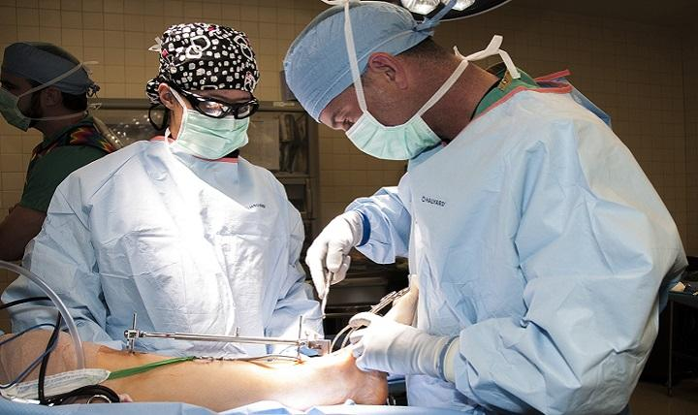
God cures and the Doctor sends the Bill
EVERY MOM IS A DOCTOR WITHOUT MBBS DEGREE

Slide 11
MODULES
APPOINTMENT
BILLS
OPERATIONS
DIAGNOSIS
PHARMACY
SEARCH
LOGIN
DOCTORS
PATIENT
REPORTS
ADD
STAFF

Slide 12
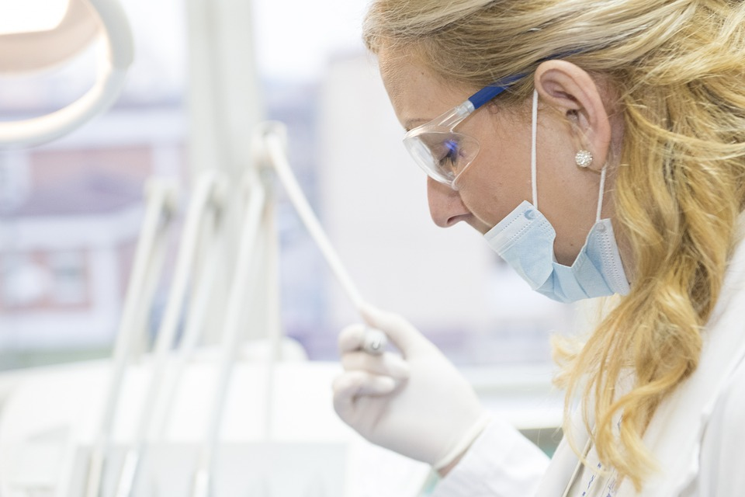
HOSPITAL DETAILS
DETAILS OF DOCTORS.
HOSPITAL CHARGES.
BLOOD DONATION.
HISTORY OF HOSPITAL.
FACILITIES IN HOSPITAL.
LIST OF STAFF.

Slide 13
if(opt==1)
{
while(opt4!=0)
{
cout<<"1 details of doctors"<<endl;
cout<<"2 hospital charges"<<endl;
cout<<"3 blood donation"<<endl;
cout<<"4 history of hospital"<<endl;
cout<<"5 facilities in hospital"<<endl;
cout<<"6 list of staff"<<endl;
cout<<"enter option for the following details"<<endl;
cin>>opt1;
This code provides details of hospital to the user.

Slide 14

APOLLO HOSPITAL
DIRECTOR OF HOSPITAL
-> K.ANIL REDDY

Slide 15
Patient details
Name of the patient.
Address of the patient.
Gender.
Blood group.
Contact no.
Age
Patient Serial no.
Patient Diseases.

Slide 16
ADD PATIENT
1.NUMBER OF PATIENTS.
2.PATIENT DETAILS.

Slide 17
if(i==1)
{
time_t rawtime;
struct tm * timeinfo;
time ( &rawtime );
timeinfo = localtime ( &rawtime );
cout<< asctime (timeinfo);
ofstream pat_file;
char fname[20];
cout<<"Enter the patient's file name : "<<endl;
cin.ignore();
gets(fname);
pat_file.open(fname);

Slide 18
if(!fname)
{
cout<<"Error while opening the file"<<endl;goto b;
else
{
struct patient_info
{
char name[20];
char address[100];
char contact[10];
char age[5];
char gender[8];

Slide 19
char blood_gp[5];
char disease_past[50];
char id[15];
};
patient_info ak;
cout<<"Name : ";pat_file<<"Name : ";gets(ak.name);pat_file<<ak.name<<endl;
cout<<"Address : ";pat_file<<"Address : ";gets(ak.address);pat_file<<ak.address<<endl;
cout<<"Contact Number : ";pat_file<<"Contact Number : ";gets(ak.contact);pat_file<<ak.contact<<endl;
cout<<"Age : ";pat_file<<"Age : ";gets(ak.age);pat_file<<ak.age<<endl;
cout<<"gender : ";pat_file<<"gender : ";gets(ak.gender);pat_file<<ak.gender<<endl;

Slide 20
cout<<"Blood Group : ";pat_file<<"Blood Group : ";gets(ak.blood_gp);pat_file<<ak.blood_gp<<endl;
cout<<"Any Major disease suffered earlier : ";pat_file<<"Any Major disease suffered earlier : ";gets(ak.disease_past);pat_file<<ak.disease_past<<endl;
cout<<"Patient ID : ";pat_file<<"Patient ID : ";gets(ak.id);pat_file<<ak.id<<endl;
cout<<"Information Saved Successfully"<<endl;
}
goto b;
} }

Slide 21
SEARCH PATIENT
else if(i==3)
{
fstream pat_file;
cout<<"Enter the patient's file name to be opened : "<<endl;
cin.ignore();
gets(fname);
pat_file.open(fname, ios::in);
if(!pat_file)
{
cout<<"no file created"<<endl;goto b;
}

Slide 22
else
{
cout<<" Full Medical History of "<<fname<<endl;
string info;
while(pat_file.good())
{
getline(pat_file,info);
cout<<info<<endl;
}
cout<<endl;
}
goto b;
}

Slide 23
LOGIN for Staff
USER NAME = anil
PASSWORD = pass

Slide 24
LOGIN PAGE
int login()
{
string pass ="",user;
char ch;
cout<<" HOSPITAL MANAGEMENT SYSTEM "<<endl;
cout<<" LOGIN "<<endl;
cout<<"enter username"<<endl;
cin>>user;
cout << "Enter Password: "<<endl;
ch = _getch();
while(ch != 13){
pass.push_back(ch);
cout << '*';
ch = _getch();
}
if(user=="anil"&&pass == "pass"){
gotoxy(46,17);
cout << "Access Granted! "<<endl;
}else{
cout << "Access Aborted...Please Try Again"<<endl;
login();
}
}

Slide 25
FUNCTION USED
1.VOID INSERT();
2.VOID PRINT();
3.VOID GOTOXY();
4.VOID GOTO();
5.STRUCT

Slide 26


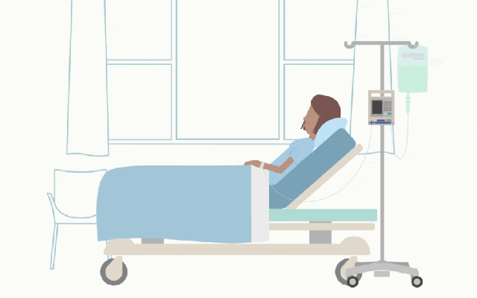


Skills & expertise

Slide 27


